Slide 1
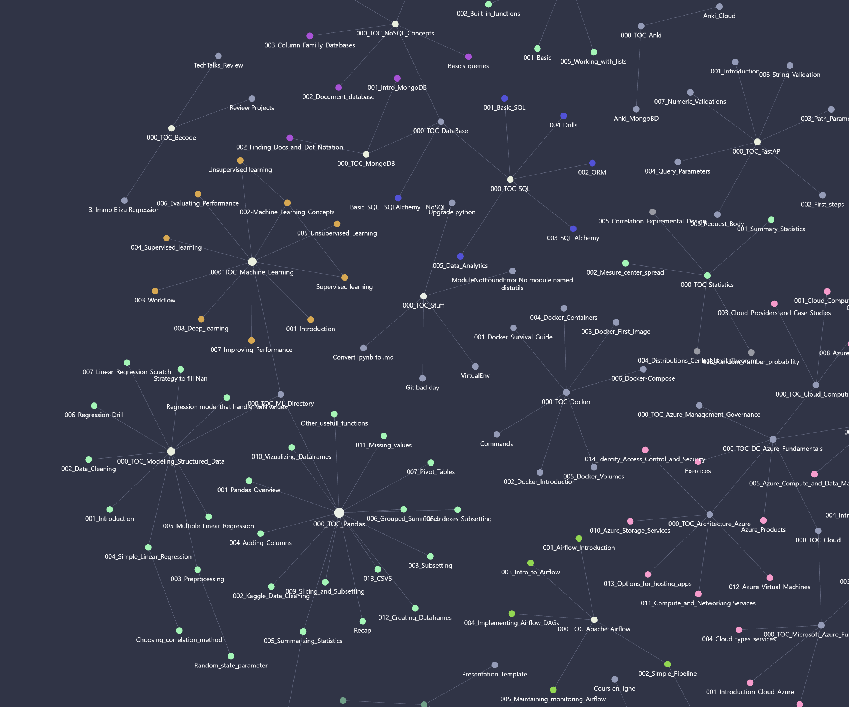
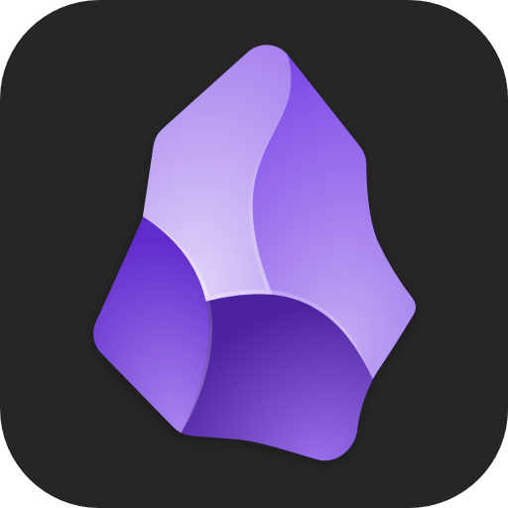
Obsidian
Presented by Laura Kriszgruber

Slide 2
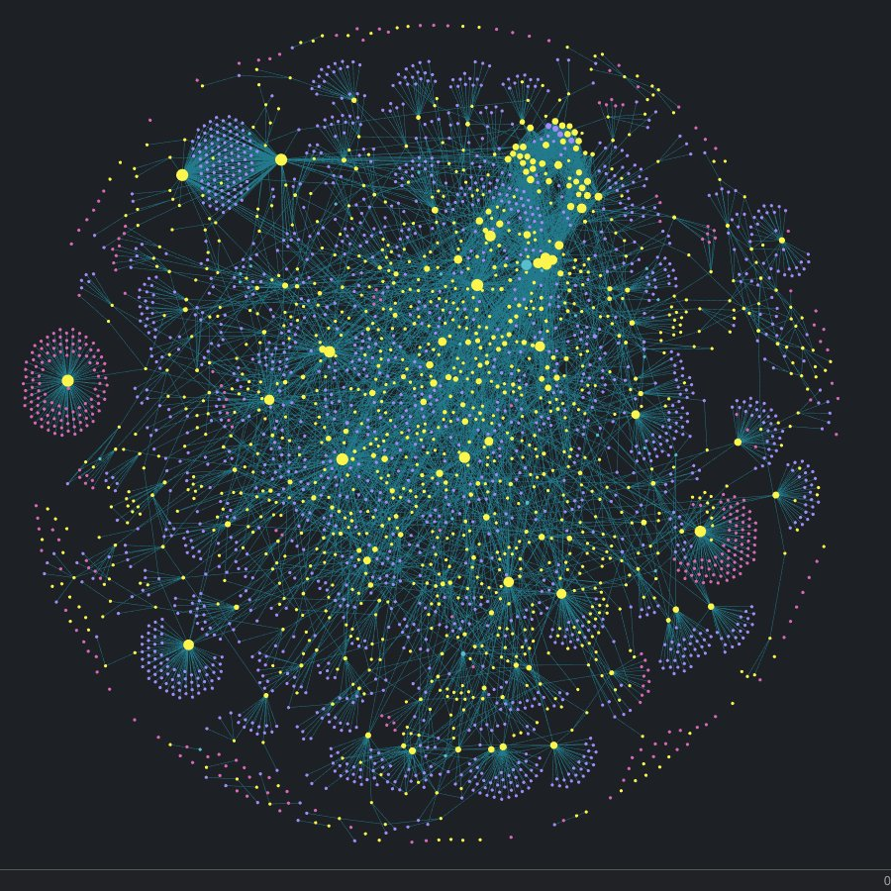
Agenda
What is Obsidian ?
Why should you use it ?
Installing it
Sync options because losing notes is Null
Making it prettier
Power ups
Sources

Slide 3
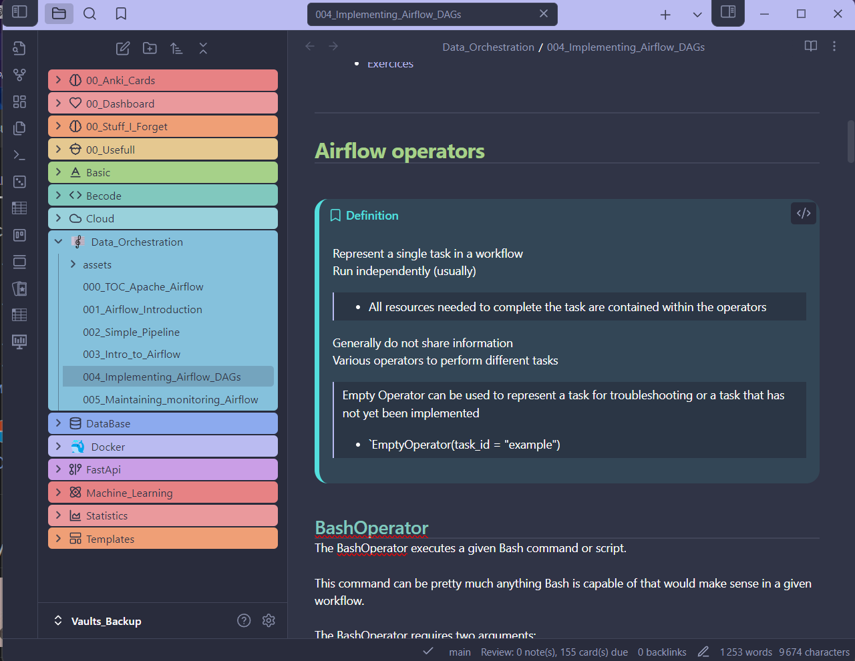
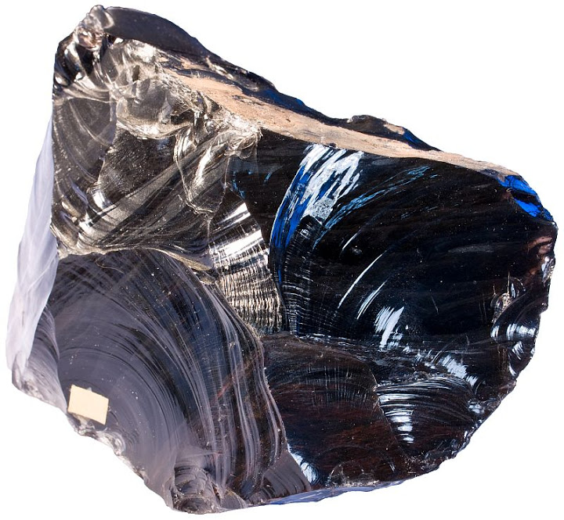
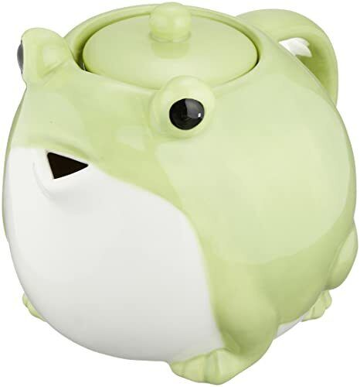
What is obsidian
408 I’m a FROG pot
Igneous rock occurring as a natural glass formed by the rapid cooling of viscous lava from volcanoes.
Extremely rich in silica (~65 to 80 %)
low in water
has a chemical composition similar to rhyolite.

Slide 4
What is obsidian the software…
Note-taking and management software
Use markdown file
Designed to organize and link notes in Vaults

Slide 5
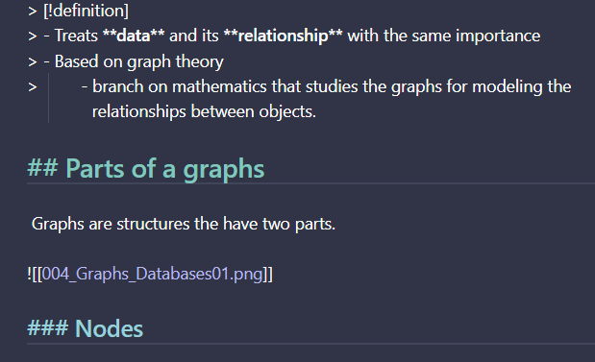

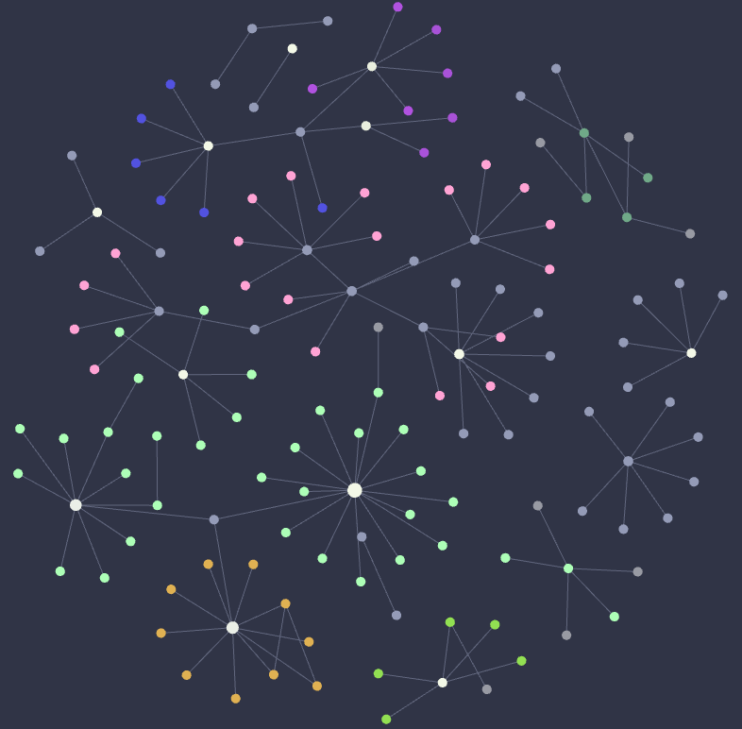

Why should you use it
Interconnection of notes and visuals
Local storage & Privacy
Customizable & Extendable
Markdown simplicity
Cross platform support
Notes:
Android and IOS also

Slide 6
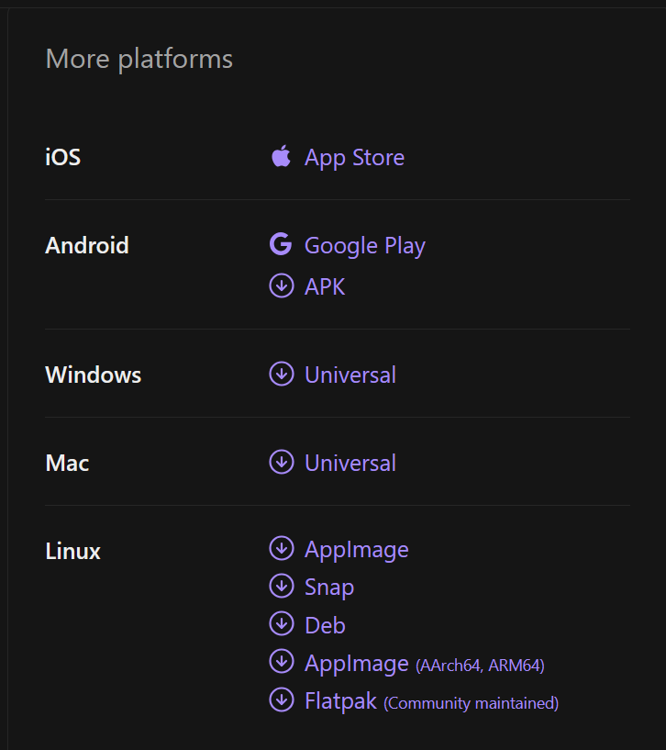
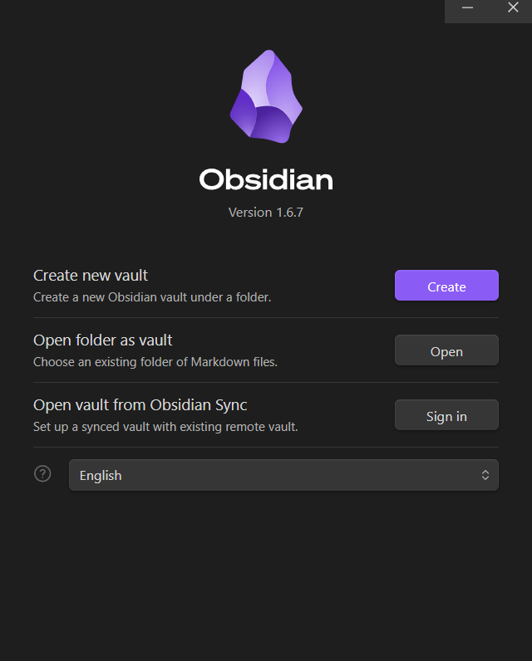
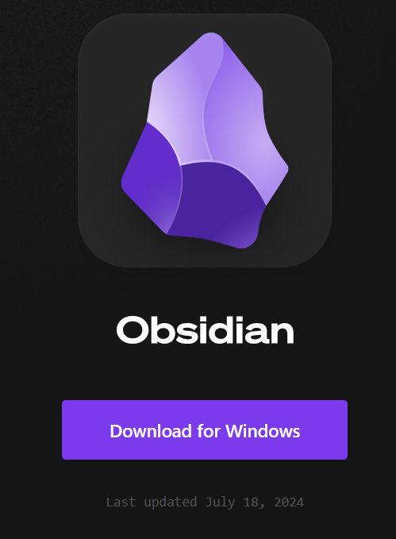
Installing

Slide 7
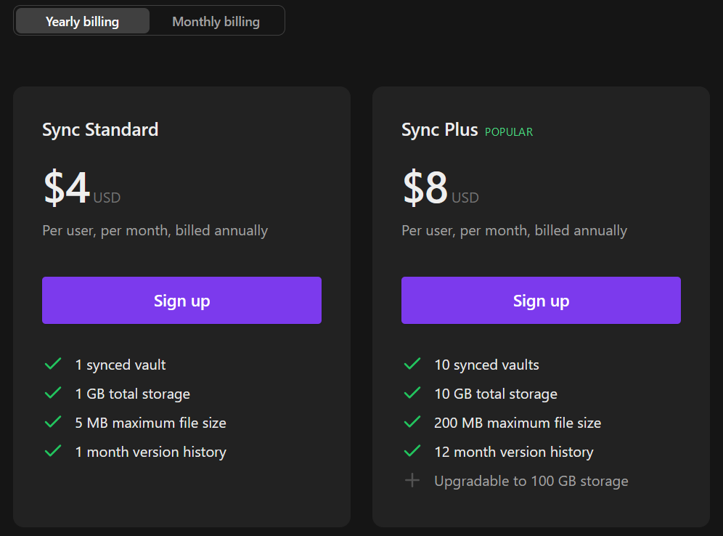
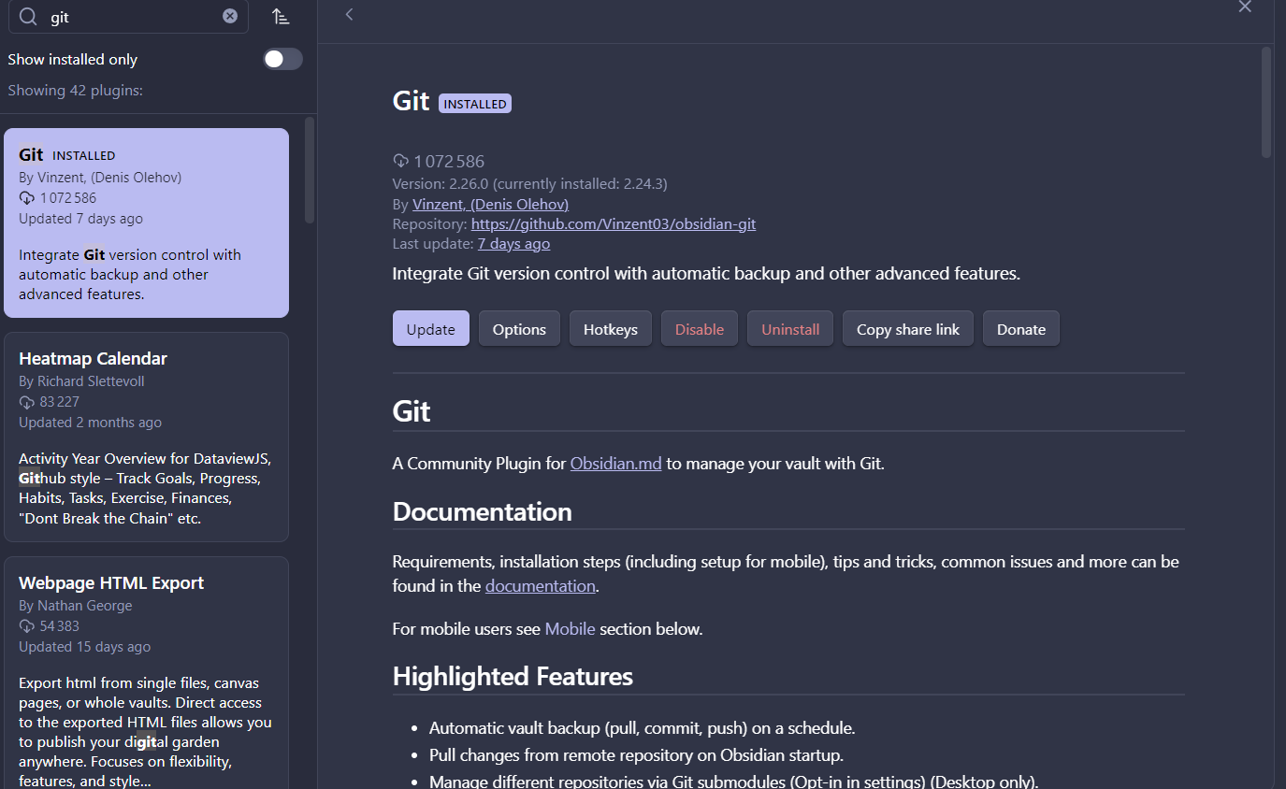
Sync options because losing your data is null

Slide 8
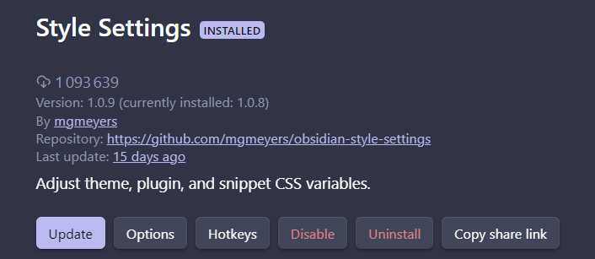
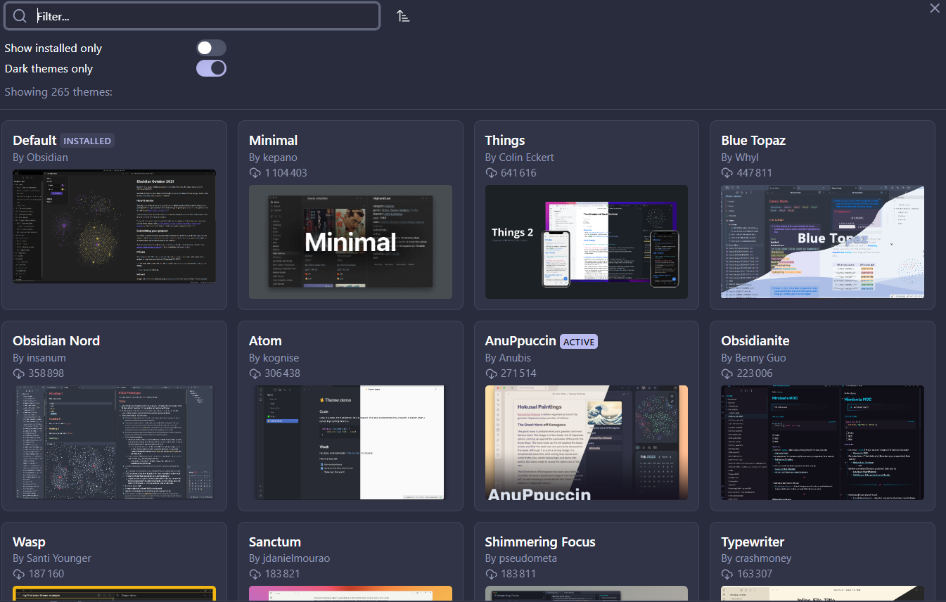
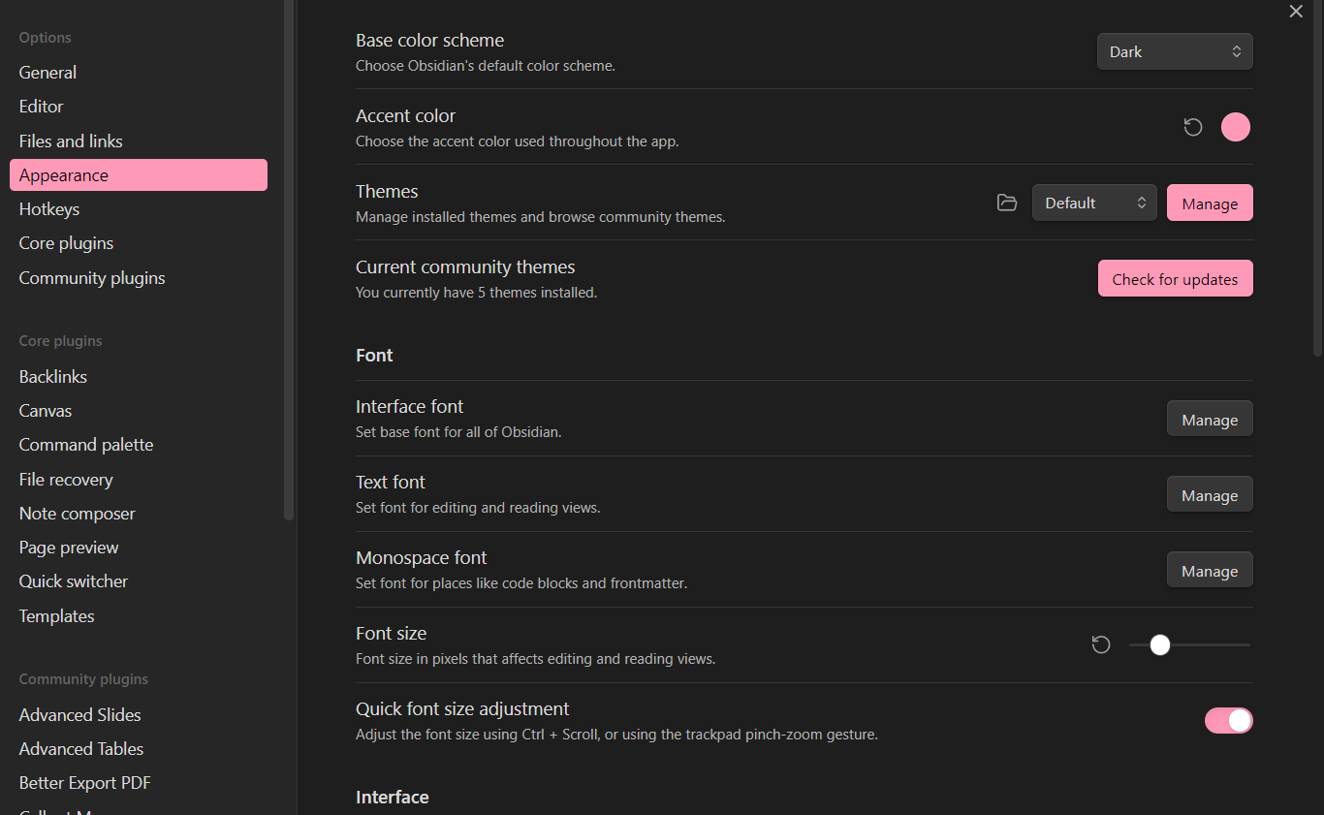
Making it prettier

Slide 9
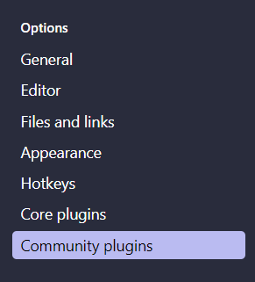
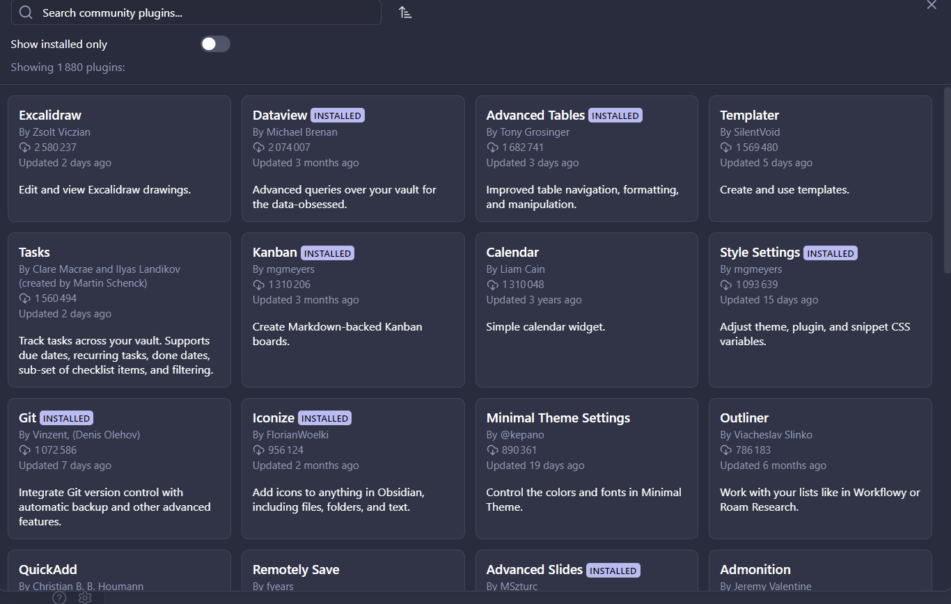
Power up
Hundred of free plugins for every need you could ever have.
Recommendations
Automatic Table of contents
Callout manager
Dataview
HTML tags Autocomplete
Image Converter / Paste image rename
Markdown table editor
Iconize
Style setting

Slide 10
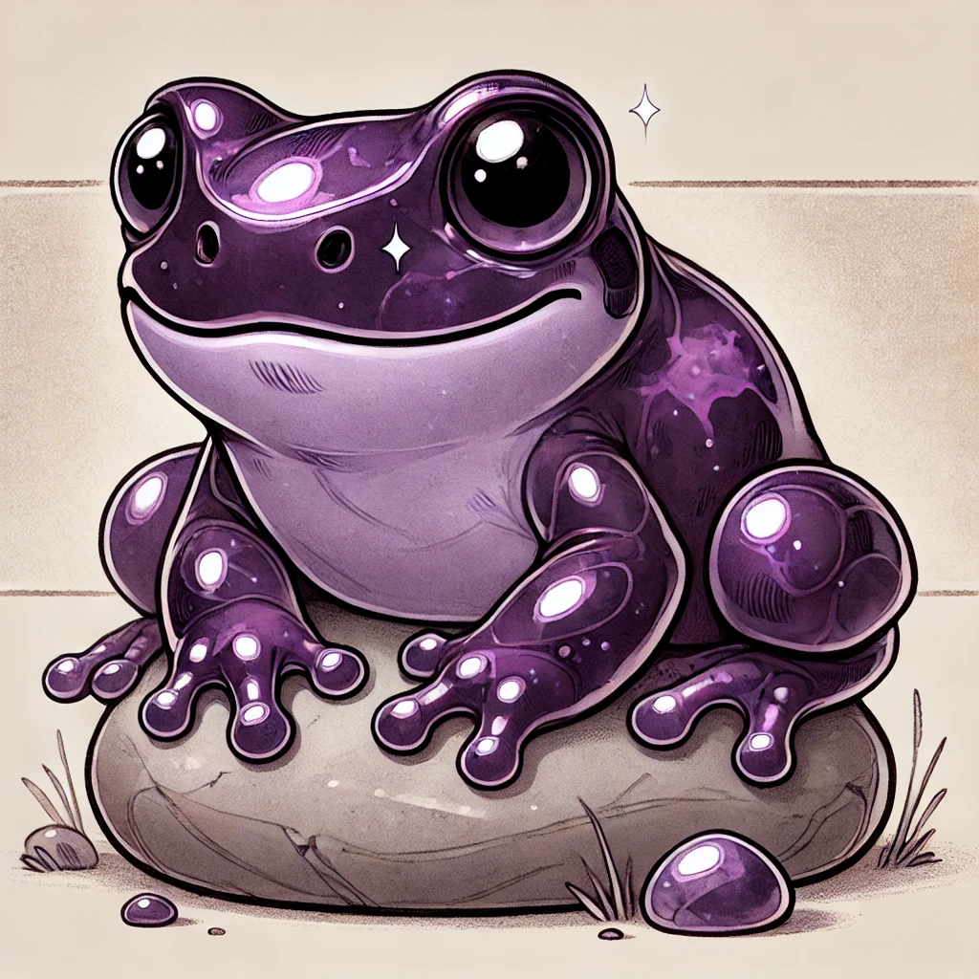
Thank you for listening

Slide 11
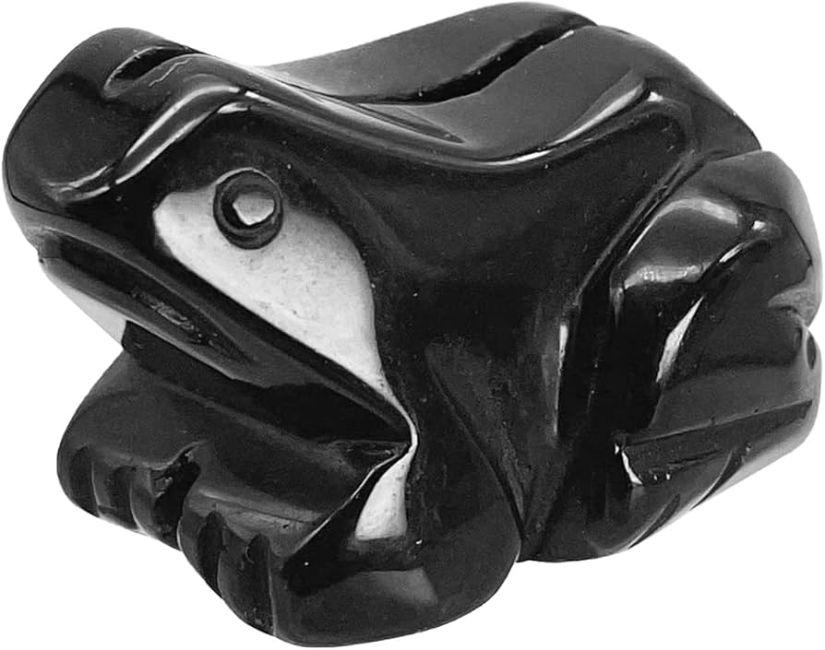
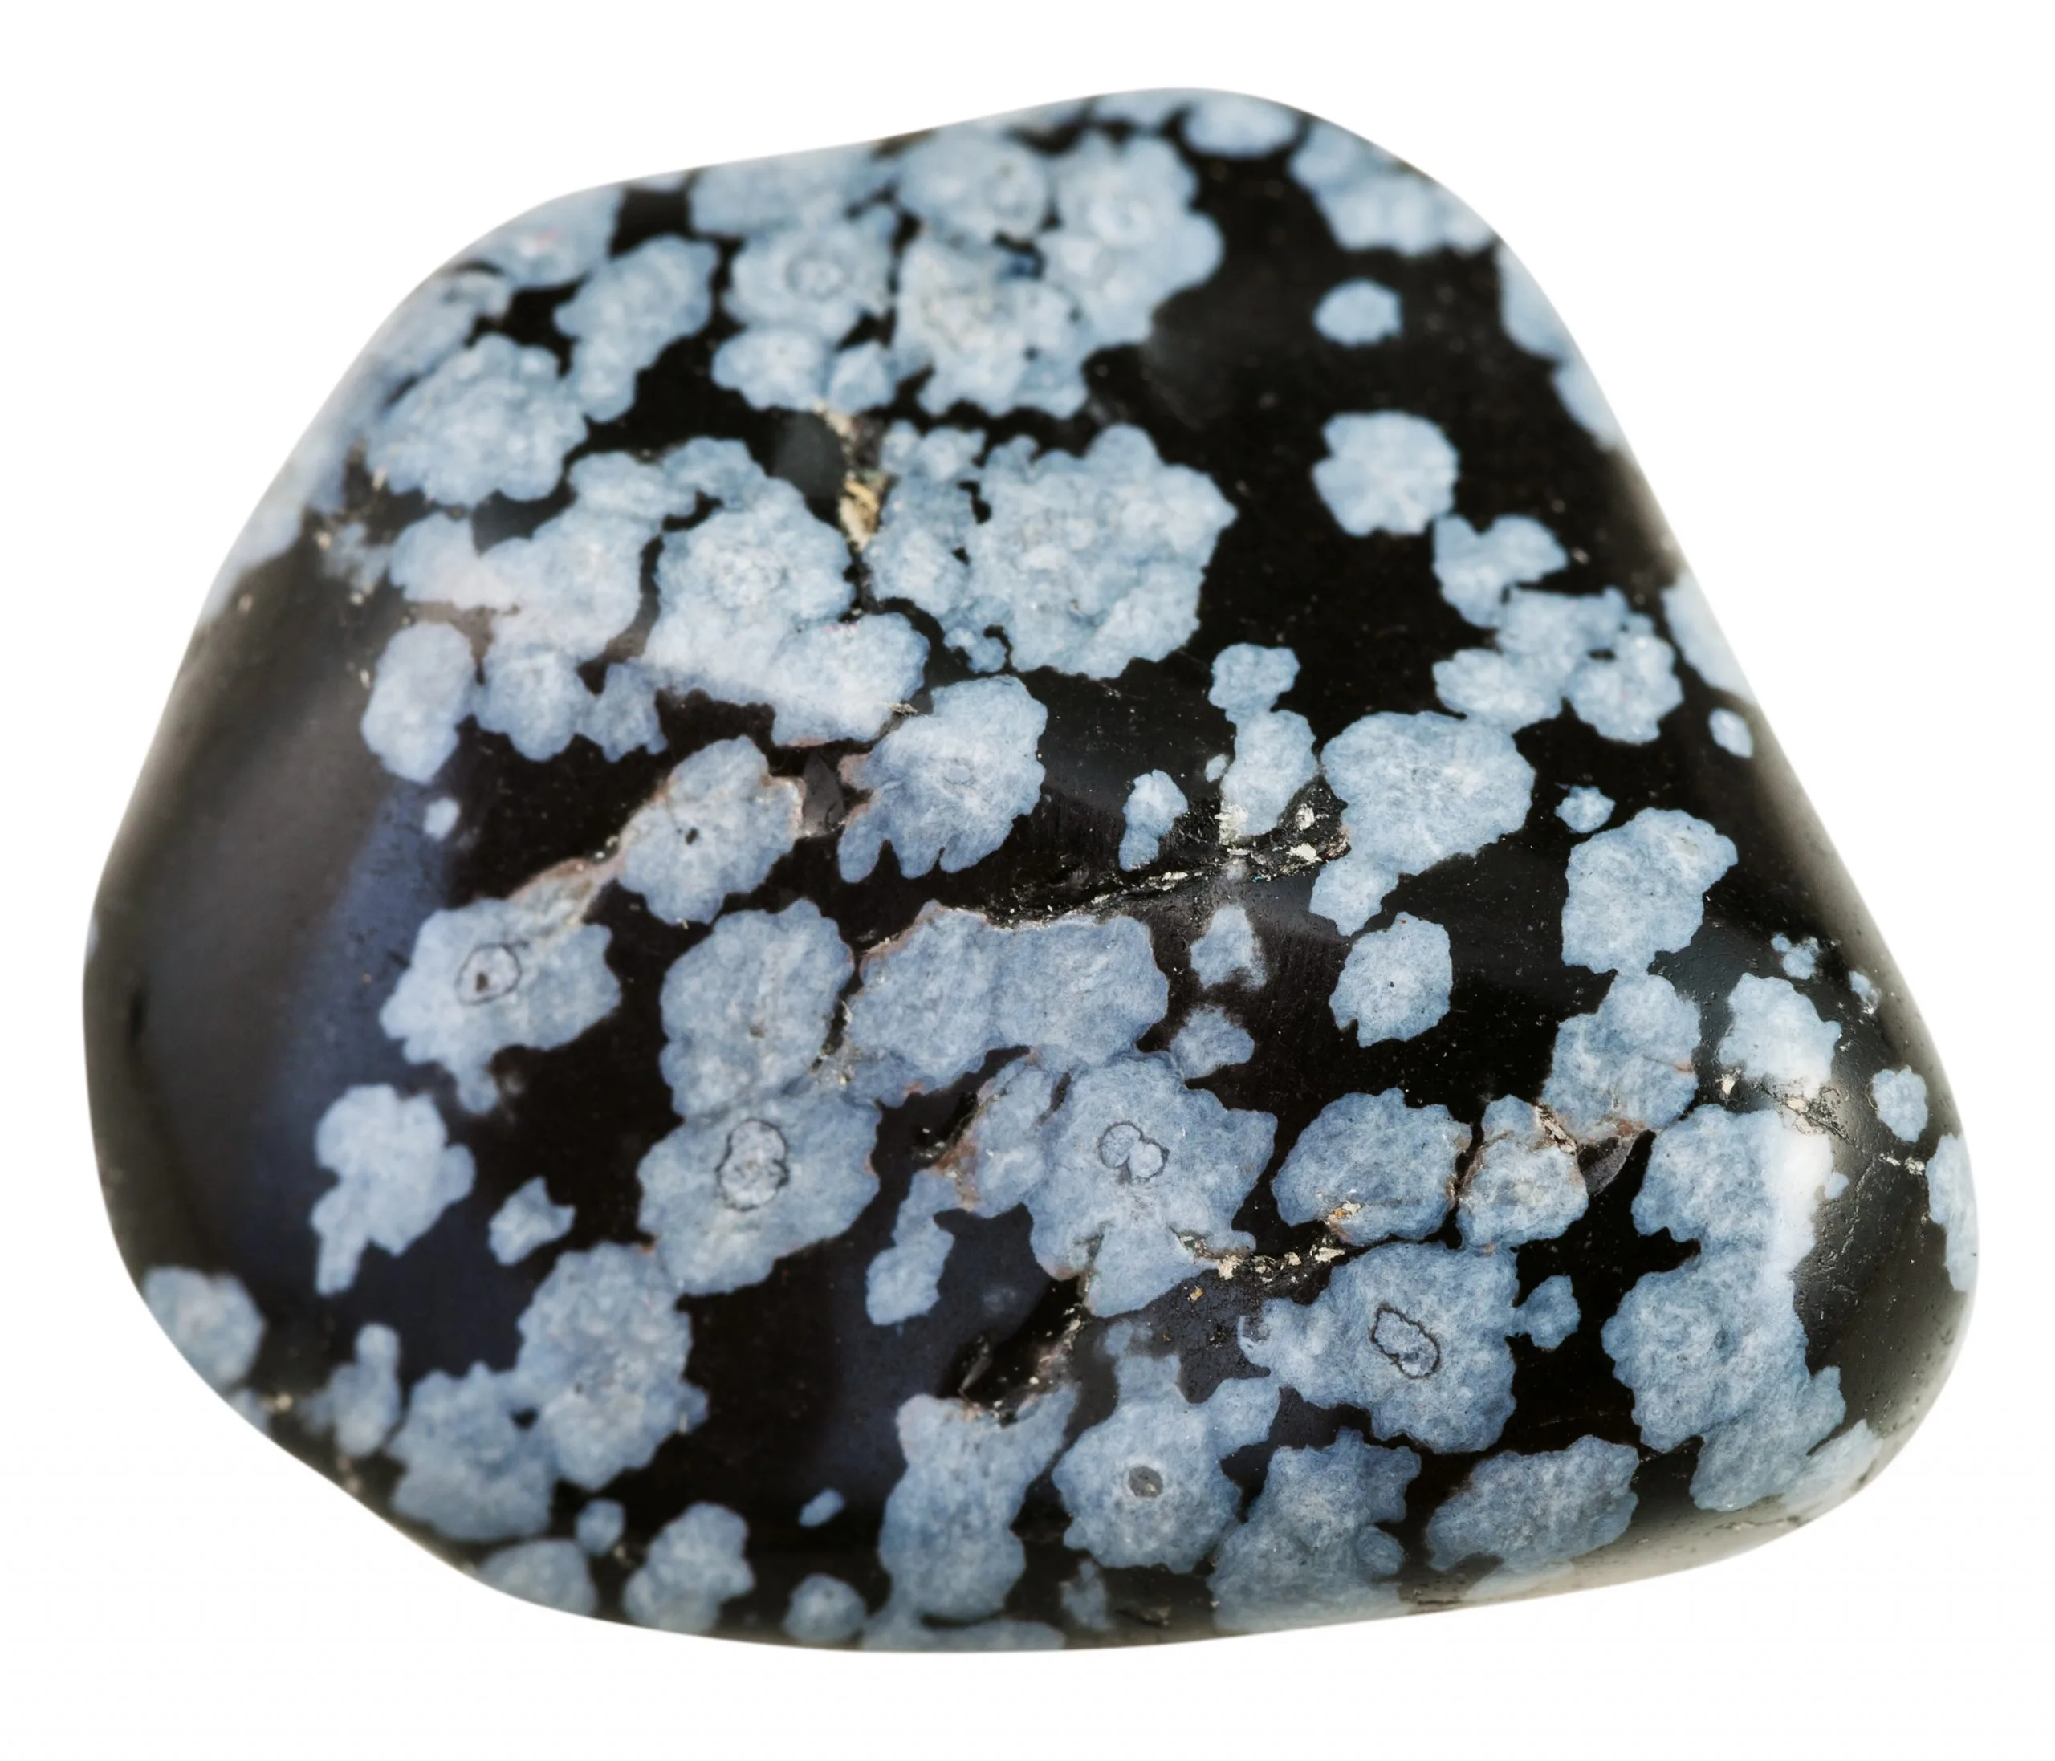
Sources
https://obsidian.md/
Yours Truly

